Slide 1

Apache Airflow Overview

Slide 2
Agenda
Airflow overview
DAG overview
Airflow Architecture
Core Concepts
Demo

Slide 3
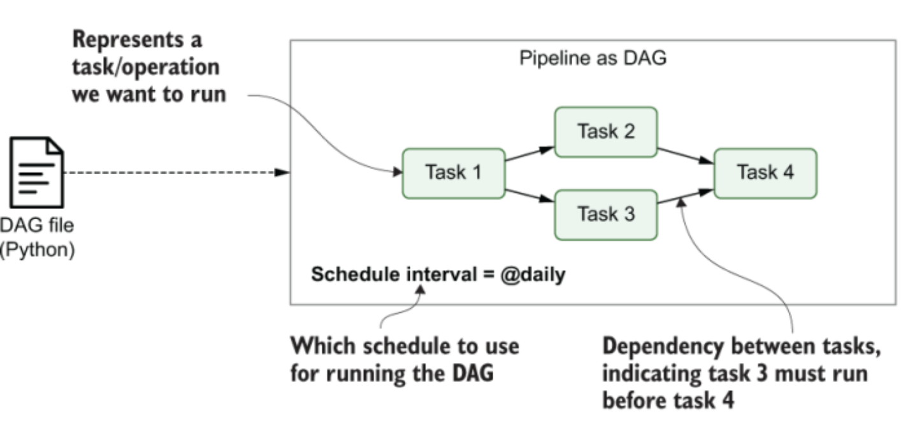
About Airflow
Apache Airflow is an open-source platform for developing, scheduling, and monitoring batch-oriented workflows.
Airflow is a workflow manager that allows pipelines to be defined as directed acyclic graph (DAG) of tasks where nodes of graph are tasks and directed edges defines the dependencies between tasks.
DAGs are defined using python code where set of tasks and its dependencies are defined. Also, DAG contains additional metadata indicating Airflow how/when DAG should be executed.

Slide 4
About Airflow
Defining Airflow DAG programmatically using Python provides a lot of flexibility. Ex. dynamically generate optional tasks depending on certain conditions OR generate entire DAGs based on external metadata or configuration files.
Airflow extensions enables to execute tasks on wide variety of systems like multi cloud platforms, external DB systems etc. allowing to build complex pipeline bringing together data processes across many different systems.
Airflow can handle failure of a task by retrying them a couple of times which can help task recover from any intermittent failures.
Airflow’s rich web interface provides an easy view for monitoring the results of pipeline runs and debugging any failures that may have occurred.
Support for Incremental Processing - Rich scheduling semantics allow building efficient pipelines that use incremental processing to avoid expensive recomputation of existing results.
Backfilling -

Slide 5
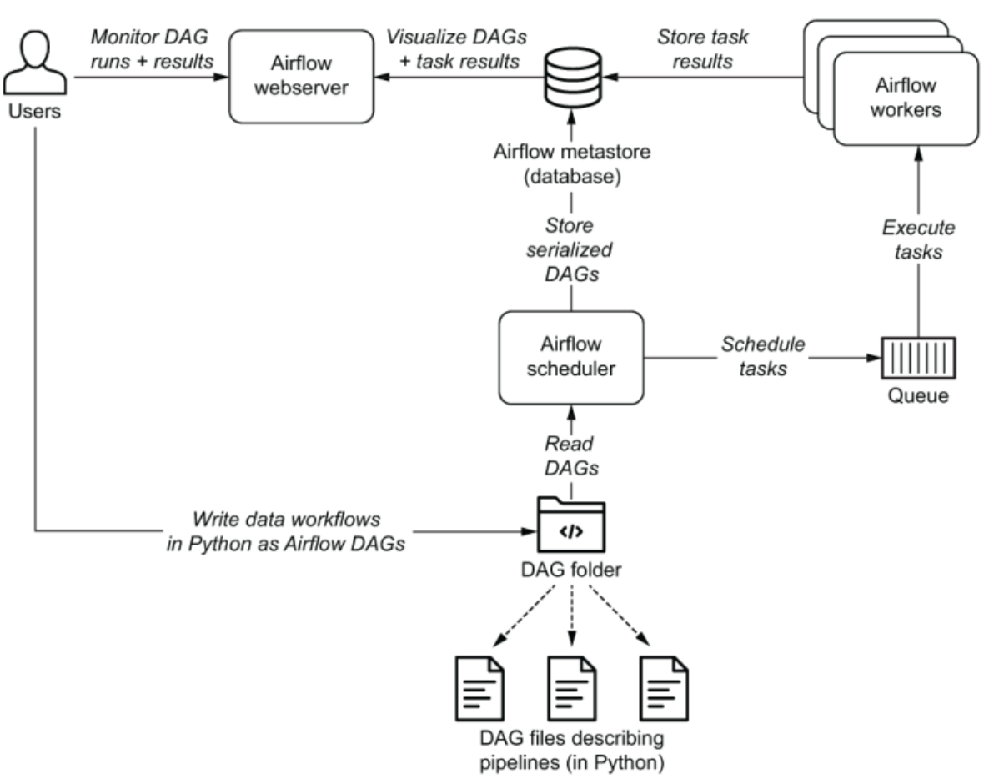
Components of Airflow
Airflow is organized across below main components:
Airflow Scheduler
Airflow Worker
Airflow Webserver
Metadata Database
Notes:
The Airflow scheduler —Parses DAGs, checks their schedule interval, and (if the DAGs’ schedule has passed) starts scheduling the DAGs’ tasks for execution by passing them to the Airflow workers.
The Airflow workers —Pick up tasks that are scheduled for execution and execute them. As such, the workers are responsible for actually “doing the work.”
The Airflow webserver —Visualizes the DAGs parsed by the scheduler and provides the main interface for users to monitor DAG runs and their results.

Slide 6
Components of Airflow
Airflow Scheduler : It parses DAGs, validate them, checks their schedule interval and starts scheduling the DAGs’ tasks for execution by passing them to the Airflow workers.
Airflow Workers : Workers are responsible for actually “doing the work”. They pick up tasks that are scheduled for execution and execute them.
Airflow Webserver : It provides an interface to visualize the DAGs, monitor the DAG runs, debug the failures.
Metadata Database is used by the scheduler, executor and webserver to store state.

Slide 7
Airflow DAG Creation
Typically, we would need following items to create a DAG
Import Modules : import “airflow” library to create DAG objects
from airflow import DAG
Operators to create the Tasks: An operator defines a unit of work for Airflow to complete. Using operators is the classic approach to defining work in Airflow.
Tasks : Tasks determine how to execute operator’s work within the context of a DAG.To use an operator in a DAG, you have to instantiate it as a task.
Default Arguments: Dictionary of default parameters that can be implicitly passed to each of the Tasks constructor.
Go through a sample DAG Code.

Slide 8
Airflow DAG
Declare DAG : There are 3 ways to declare DAG :
Using “with DAG()”,
use a standard constructor, passing the DAG into any operators you use
use the @dag decorator to turn a function into a DAG generator
Loading DAG : Airflow loads DAGs from Python source files that has DAG definitions. These py files are placed inside configured DAG_FOLDER
Running DAG : DAGs can run in 2 ways : Manually or on a define Schedule in DAG
Every single Operator/Task must be assigned to a DAG in order to run
DAG Runs : Any time a DAG is executed, a DAG Run is created and all tasks inside it are executed.A DAG Run is an object representing an instantiation of the DAG in time. There can be many runs of a DAG at the same time.

Slide 9
Core Concepts
Tasks: There are 3 type tasks a DAG can have: Operator, Sensor and TaskFlow
Task Instance : When a DAG is executed, tasks inside it are instantiated into Task instances that has a state associated with it like queued, running, scheduled, success, failed,skipped etc.
Control Flow : By default, Airflow execute Tasks when all its dependent Tasks are successful.
Task Dependencies
first_task >> second_task >> [third_task, fourth_task]
first_task.set_downstream(second_task) third_task.set_upstream(second_task)
Various ways to control the flow of Task execution are : Branching,Latest Only, Depends on past,Trigger Rules
Passing data between tasks
XComs : a system where you can have tasks push and pull small bits of metadata
Taskflow APIs : automatically passes data between tasks via implicit XComs

Slide 10
Core Concepts
Operators : An Operator is conceptually a template for a predefined Task.Airflow has a very extensive set of operators available. Examples : BashOperator, PythonOperator, EmailOperator, DockerOperator, OracleOperator etc.
Sensors : Special type of Operator that are designed to do exactly one thing - wait for something to occur. It can be time-based, or waiting for a file, or an external event, but all they do is wait until something happens, and then succeed so their downstream tasks can run.
Taskflow : TaskFlow takes care of moving inputs and outputs between Tasks inside a DAG.Also,it automatically calculates dependencies between Tasks.
Executors : Executors are the mechanism by which task instances get run.Airflow can only have one executor configured at a time.There are two types of executor - that run tasks locally (Local Executor)or remotely (Celery Executor).

Slide 11
Demo
Installing Airflow on Dockers
DAG Sample code
Airflow UI
Executing one DAG manually

Slide 15
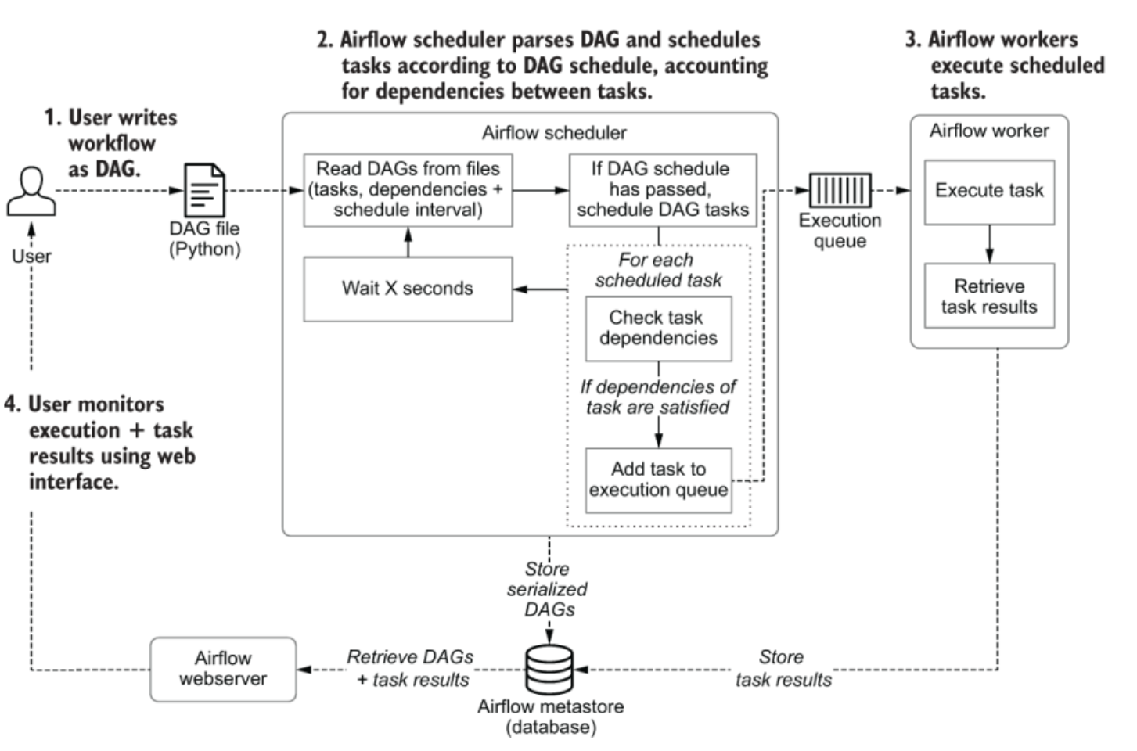
Process of DAG execution using Airflow

Slide 16
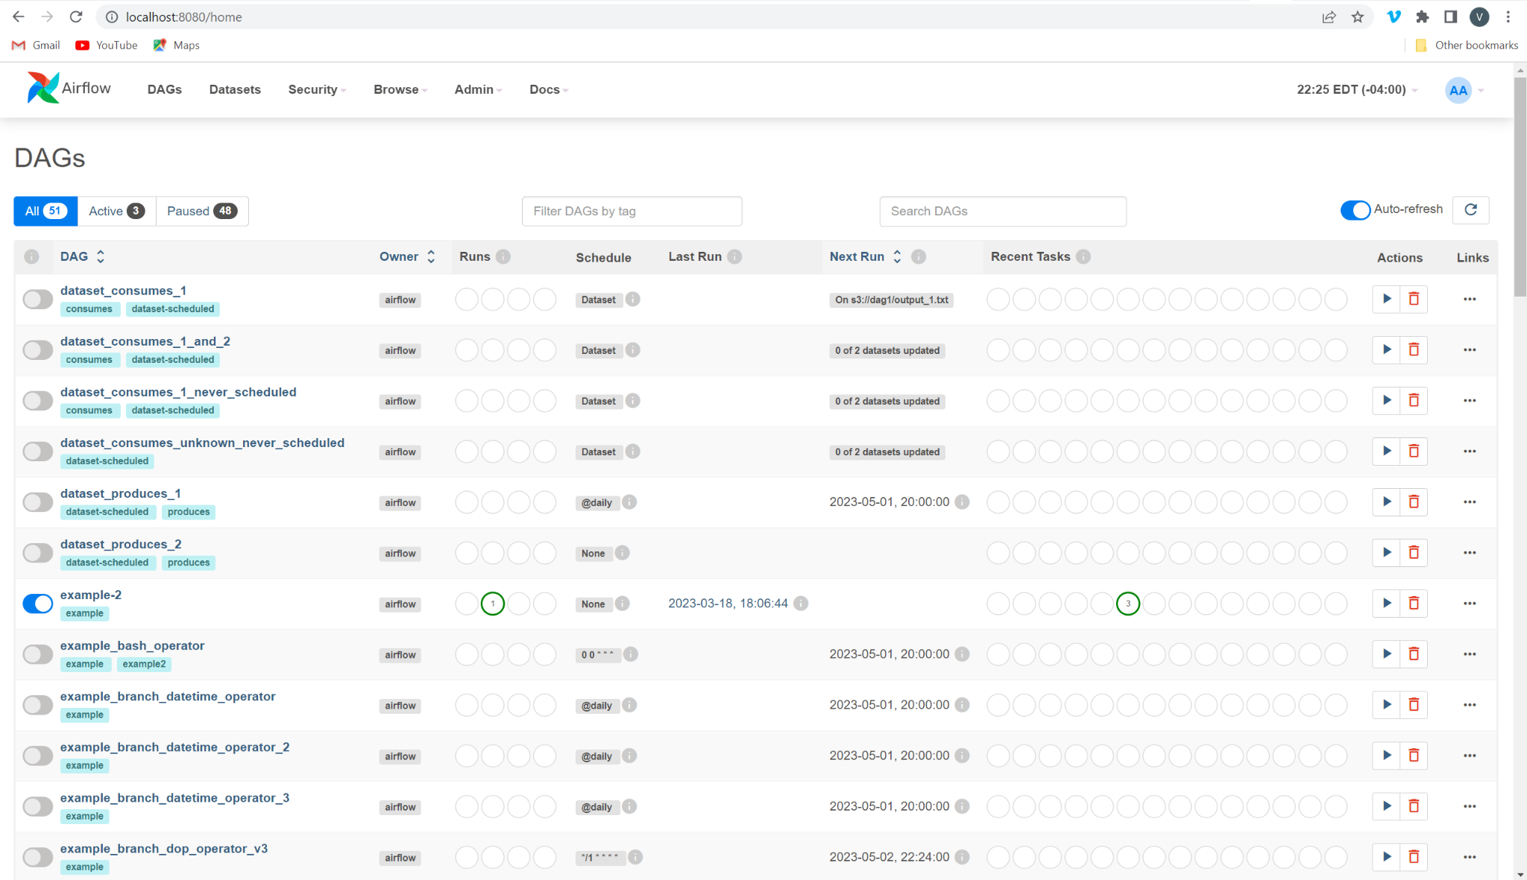
Airflow UI understanding

Slide 17
Trigger Rule
Trigger Rules of a task are set of conditions that Airflow applies to a task that determines if task is ready to execute.
Trigger Rules of a task are function of its dependencies ie the upstream tasks in the DAG.
Airflow’s default trigger rule is “all_success”, which states that all of a task’s dependencies must have completed successfully before the task itself can be executed.

Slide 18
Sharing Data between Tasks
Sharing Data using XComs
Taskflow API

Slide 19
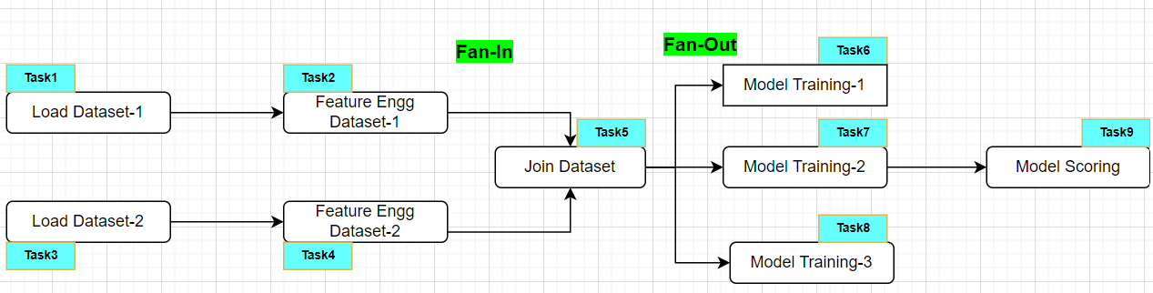
Airflow Task Dependency patterns
Linear Dependencies
Task1 >> Task2 >> Task3 >> ….>> Taskn
Fan-In/Fan-Out Dependencies
Fan-Out Dependency (linking one task to multiple downstream tasks) Task5 >> [Task6, Task7, Task8]
Fan-In Dependency (one task has dependency on multiple upstream tasks) [Task2,Task3] >> Task5

Slide 20
Branching within DAG using BranchPythonOperator
Executing Tasks Conditionally using AirflowSkipException

